Slide 1
Python NumPy
Pham Trung Kien
kienptgch200815@fpt.edu.vn

Slide 2
Agenda
What is NumPy?
Install NumPy
Create and Use NumPy array
Create and Access NumPy array
Manipulate NumPy array
NumPy operations
NumPy Special Functions

Slide 3
1. What is NumPy?

Slide 4
Definition
NumPy stands for Numerical Python.
NumPy is a open-source Python library:
Written partially in Python, but most of the parts are written in C or C++.
Work efficiently with arrays and matrices (multi-dimensional arrays)
Offer efficient numerical operations on large quantities of data
NumPy array:
Can hold homogeneous data-types.
More flexible than normal Python list.
More high-processing-speed than list.

Slide 5
NumPy vs List?
NumPy array
List
Collection of homogeneous data-types.
Store data in contiguous memory locations.
Smaller memory consumption.
Better runtime behavior.
Collections of heterogeneous data types.
Store data in non-contiguous memory locations.
Core python.

Slide 6
2. Install NumPy

Slide 7
Require Python and PIP before installing NumPy:
PIP: a package manager for Python packages, or modules
Python version 3.4 or later, PIP is included by default.

Slide 8
Check if PIP installed
Use ‘pip –version’ command in cmd

Slide 9


Install and import NumPy
Using ‘pip install numpy’ to install NumPy
Import NumPy

Slide 10
3. Create and Use NumPy array

Slide 11
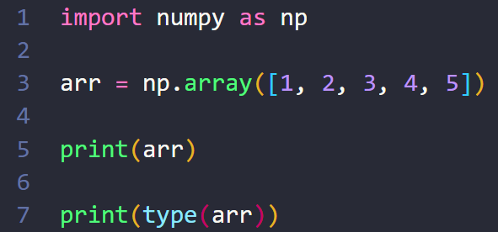

Create NumPy array
NumPy is used to work with arrays
The array object in NumPy is called ndarray
(n-dimensional array)
Using the array() function to create a NumPy ndarray object

Slide 12
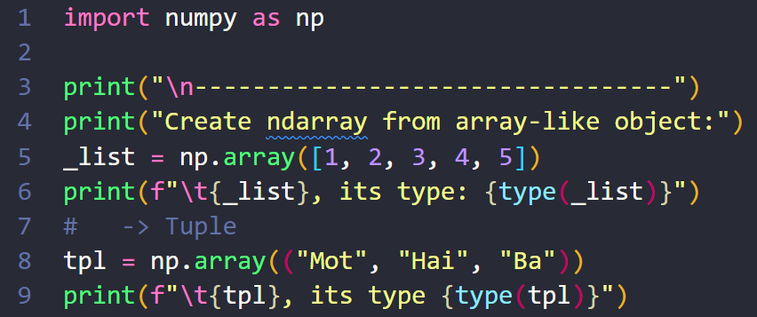
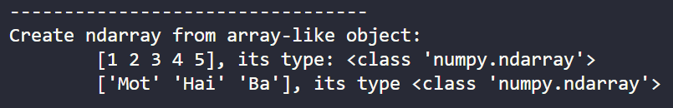
Create ndarray from array-like objects
Array-like objects can be converted into ndarrays
List
Tuple

Slide 13
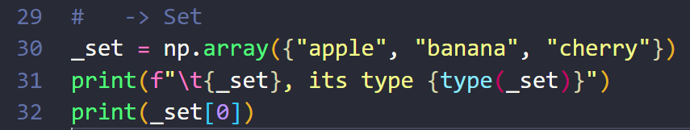
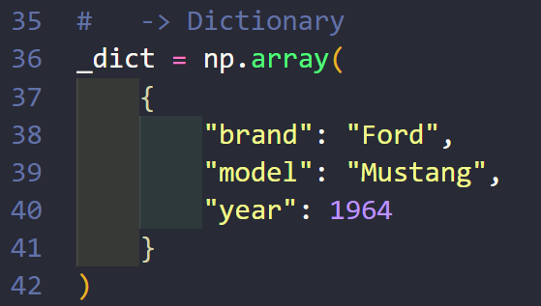
Sets and Dictionary can also be converted into ndarrays.
Those ndarrays cannot be accessed.
An IndexError is thrown when trying to access those ndarrays.

Slide 14
Dimensions in Arrays
A dimension in arrays is one level of array depth (nested arrays):
Nested array: are arrays that have arrays as their elements.
The maximum number of dimensions is 32.
A ValueError is raised if trying to create 33 or more dimension.
Multi-dimension arrays can be defined by passing:
N-dimension list.
Using ndmin argument in array() method.

Slide 15
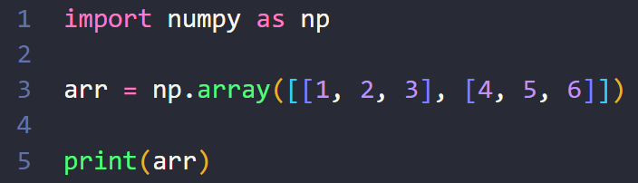
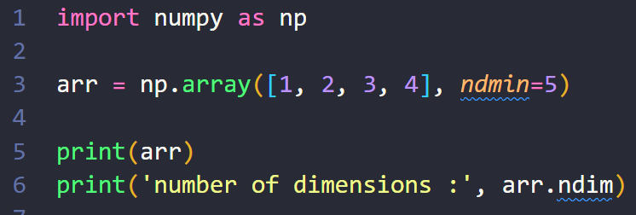


Dimensions in Arrays
Using multi-dimension list
Using ndmin argument

Slide 16
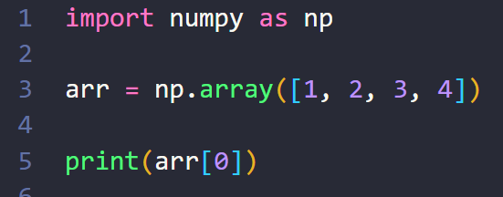

NumPy Array Indexing
Array indexing is the same as accessing an array element.
An array element can be accessed by referring to its index number.
The indexes in NumPy arrays start with 0.

Slide 17

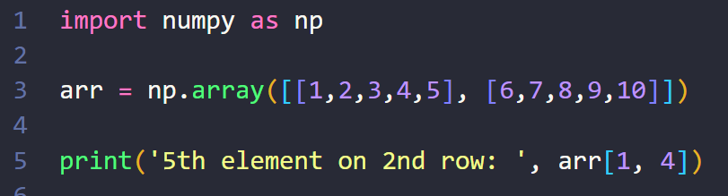
Access n-d Arrays
Use comma separated integers representing the dimension and the index of the element to access elements from n-d arrays
2-d: arr[0, 1]
3-d: arr[0, 1, 2]
…

Slide 18
Access n-d Arrays
Use comma separated integers representing the dimension and the index of the element to access elements from n-d arrays
2-d: arr[0, 1]
3-d: arr[0, 1, 2]
…

Slide 19

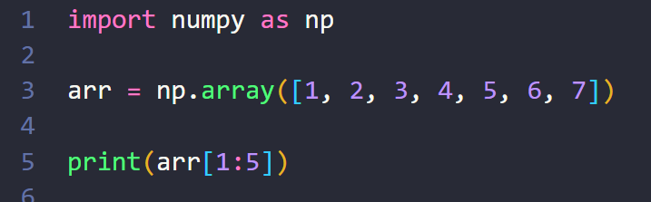
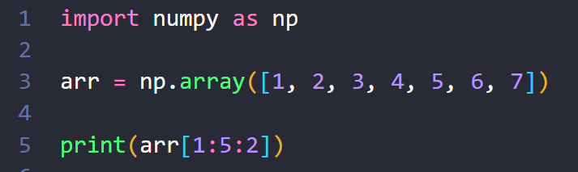

NumPy Array Slicing
Slicing in python means taking elements from one given index to another given index
Slice:
Normal [start:end] .
With step [start:end:step] .
The result includes the start index, but excludes the end index.

Slide 20
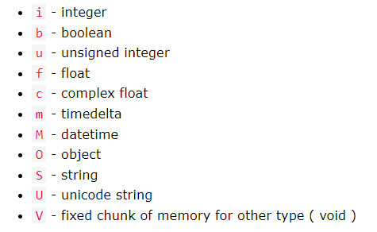
NumPy Data Types
NumPy has some extra data types

Slide 21
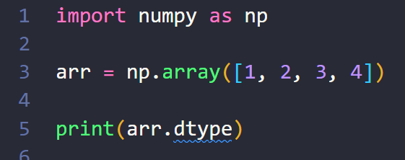
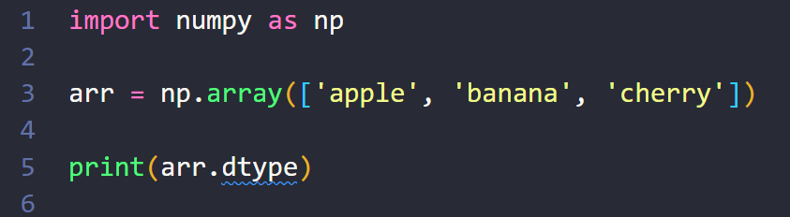
Check the data type of an array
>> int32
>> <U6
(Unicode string)

Slide 22
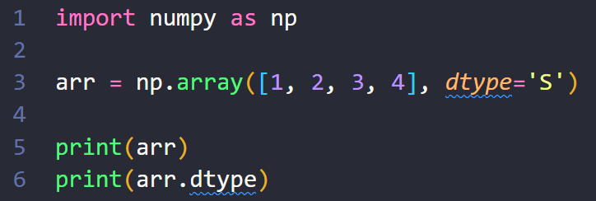
Creating Arrays With a Defined Data Type
To define the expected data type of the array elements use dtype argument in array() method.
>> [b'1' b'2' b'3' b'4’]
>> |S1

Slide 23
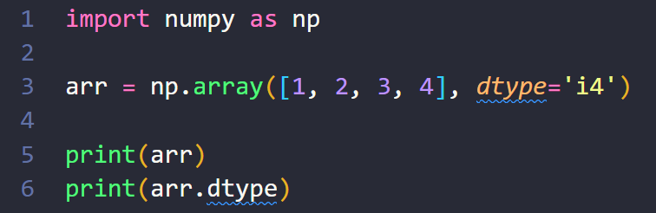
For i, u, f, S and U we can define size as well.
>> [1 2 3 4]
>> int32

Slide 24
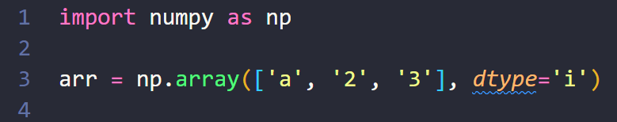
If a type is given in which elements can't be casted then NumPy will raise a ValueError.
>> ValueError: invalid literal for int() with base 10: 'a'

Slide 25
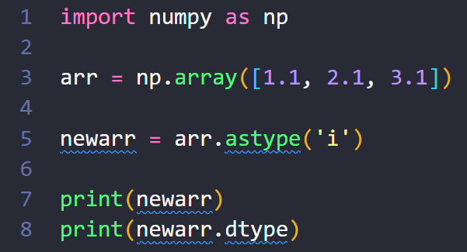
Converting Data Type on Existing Arrays
Use astype() method to change the data type of an existing array.
The astype() function creates a copy of the array.
The data type can be specified
using a string: ‘f’, ‘i’,…
directly like float, int,...
>> [1 2 3]
>> int32

Slide 26
NumPy Array Copy vs View
Copy
View
The copy is a new array.
The copy does not own the original data.
Any changes made to the copy will not affect original array and vice versa.
The view is a view of the original array.
The view owns the original data.
Any changes made to the view will affect the original array and vice versa.

Slide 27
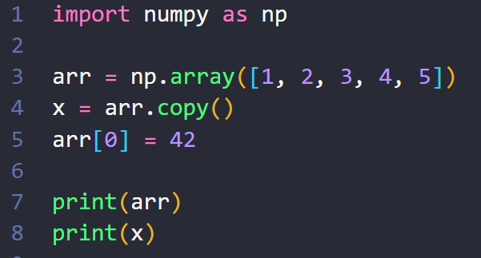
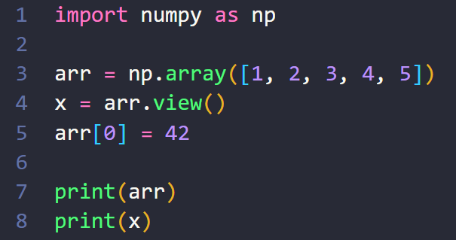
Copy
View
>> [42 2 3 4 5]
>> [1 2 3 4 5]
>> [42 2 3 4 5]
>> [42 2 3 4 5]

Slide 28
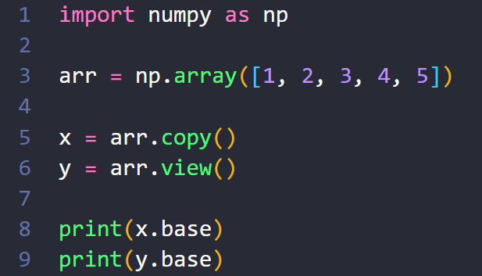
Check if Array Owns its Data
base attribute refers to the original object.
The copy returns None.
The view returns the original array.
View
>> [1 2 3 4 5]
Copy
>> None

Slide 29
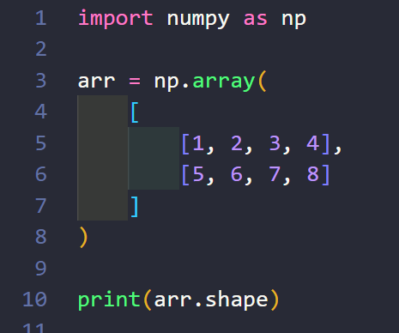
NumPy Array Shape
The shape of an array is the number of elements in each dimension.
NumPy arrays have an attribute called shape :
Return a tuple with integers at every index tells about the number of elements the corresponding dimension has
the elements in each dimension must be the same size or the shape won't work correctly
>> (2, 4)

Slide 30
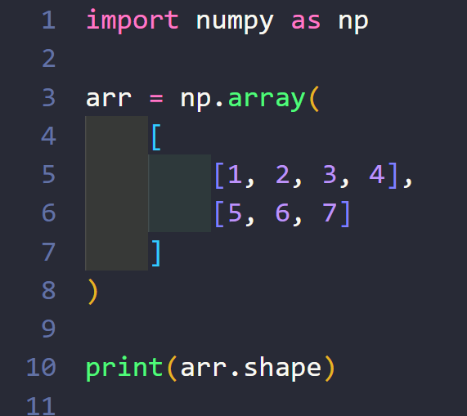
>> (2, )

Slide 31
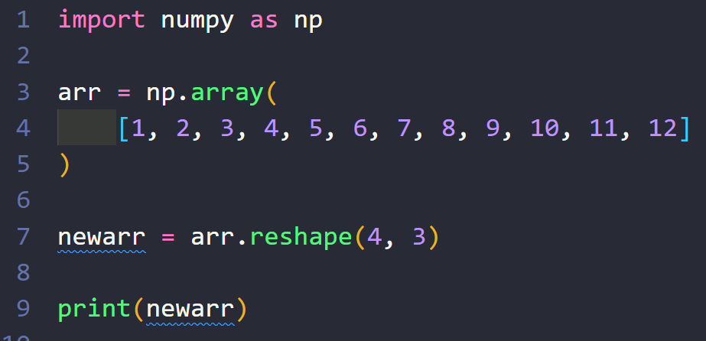
NumPy Array Reshaping
Reshaping means changing the shape of an array.
By reshaping we can
Add or remove dimensions
Change number of elements in each dimension.
>> [[ 1 2 3]
[ 4 5 6]
[ 7 8 9]
[10 11 12]]

Slide 32
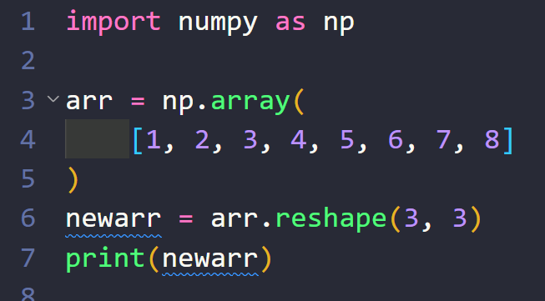
We can reshape NumPy array into any shape as long as the elements required for reshaping are equal in both shapes.
>> ValueError: cannot reshape array of size 8 into shape (3,3)

Slide 33
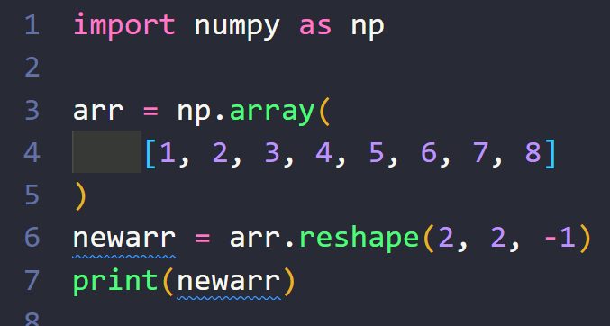
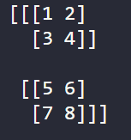
Reshape with unknown dimension
One "unknown" dimension is allowed.
Do not have to specify an exact number for one of the dimensions in the reshape method
Pass -1 as the value, and NumPy will calculate this number

Slide 34
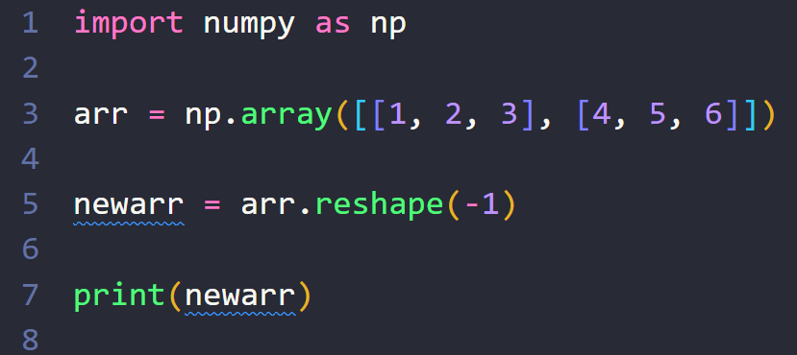
Flattening the arrays
Flattening array means converting a multidimensional array into a 1D array.
>> [1 2 3 4 5 6]

Slide 35
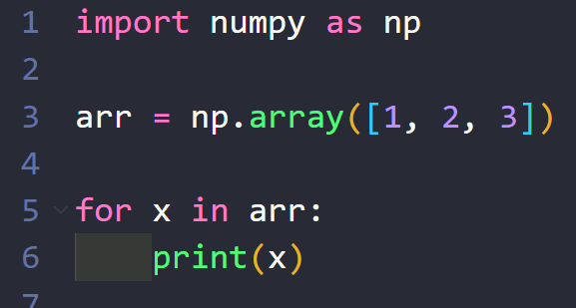
NumPy Array Iterating
Iterating means going through elements one by one.
We use for to loop through the ndarray
>> 1
2
3

Slide 36
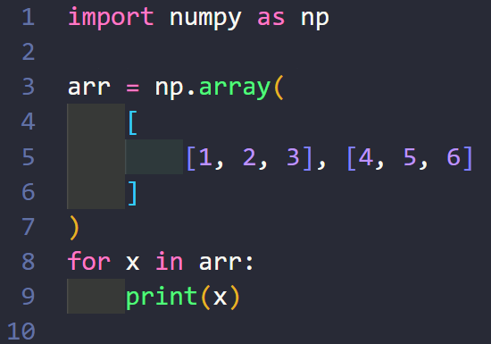
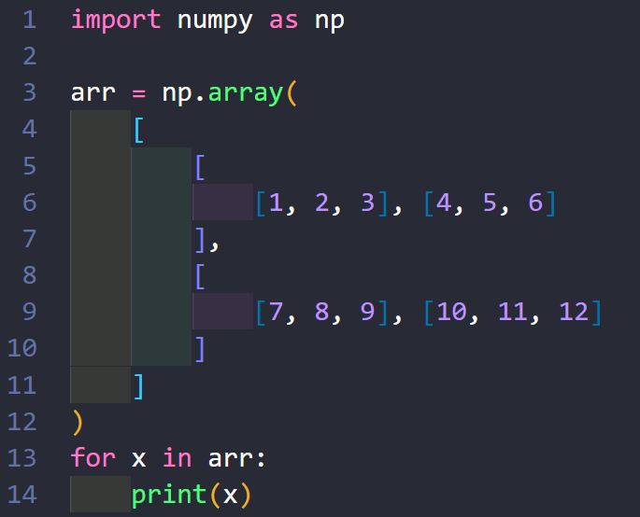
Iterating n-D Arrays (n > 1)
2-d array
3-d array
In a 2-D array it will go through all the rows.
In a 3-D array it will go through all the 2-D arrays.
[1 2 3]
[4 5 6]
[[1 2 3]
[4 5 6]]
[[ 7 8 9]
[10 11 12]]

Slide 37
Iterating n-D Arrays (n > 1)
[1 2 3]
[4 5 6]
If we iterate on a n-D array it will go through n-1th dimension one by one.

Slide 38
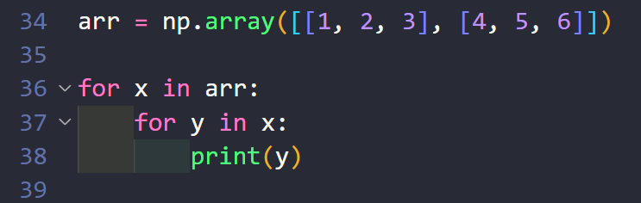
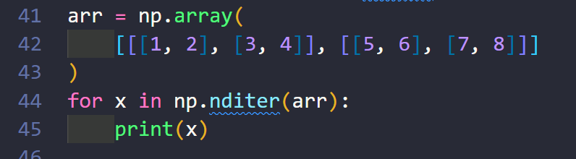
To return the actual values, the scalars, we have to iterate the arrays in each dimension.
The function nditer() helps looping through the array without worrying about write a bunch of foops
1 2 3 4 5 6 7 8
1 2 3 4 5 6 7 8

Slide 39
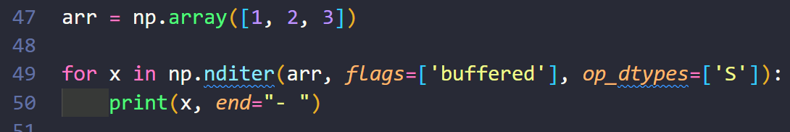
Iterating Array With Different Data Types
We can use op_dtypes argument and pass it the expected datatype to change the datatype of elements while iterating.
NumPy does not change the data type of the original element.
In order to change data type of the element, in nditer() we pass flags=['buffered'].
b'1'- b'2'- b'3'-

Slide 40
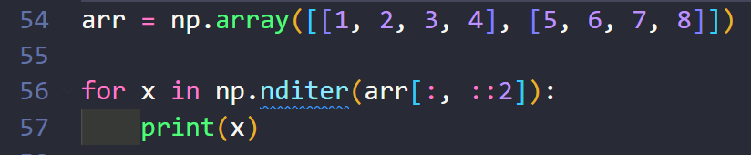
Iterating With Different Step Size
We can filter the iteration by define the step.
Similar to array indexing.
1
3
5
7

Slide 41
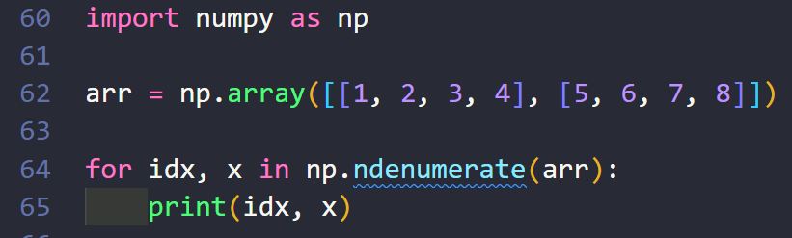
Enumerated Iteration Using ndenumerate()
Enumeration means mentioning sequence number of somethings one by one.
ndenumerate() method let us know corresponding index of the element while iterating
(0, 0) 1
(0, 1) 2
(0, 2) 3
(0, 3) 4
(1, 0) 5
(1, 1) 6
(1, 2) 7
(1, 3) 8

Slide 42
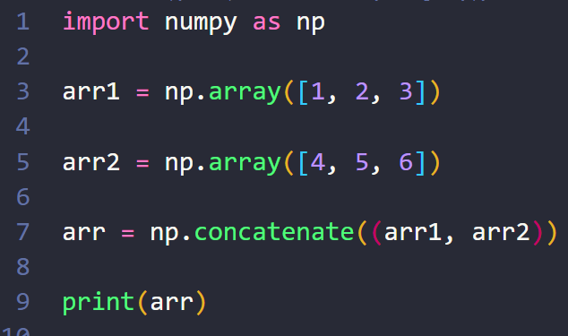
NumPy Joining Array
Joining means putting contents of two or more arrays in a single array.
In NumPy we join arrays by axes.
To join arrays, pass a sequence of arrays that we want to join to the concatenate() function, along with the axis.
Default axis is 0.
>> [1 2 3 4 5 6]

Slide 43
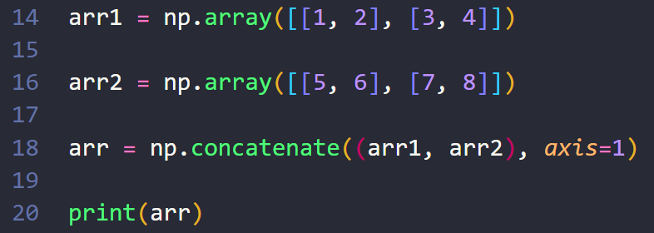
Joining 2-d array
[[1 2 5 6]
[3 4 7 8]]

Slide 44
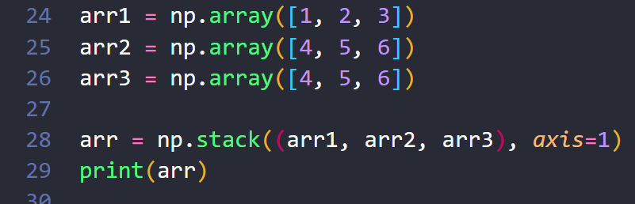
Joining Arrays Using Stack Functions
Stacking is same as concatenation, the only difference is that stacking is done along a new axis.
It can only concatenate two or more 1-D arrays along the second axis which would result in putting them one over the other.
To join 1-d arrays using stack() method with the axis.
The default axis is 0.
Axis can be only 0 or 1.
[[1 4 4]
[2 5 5]
[3 6 6]]

Slide 45
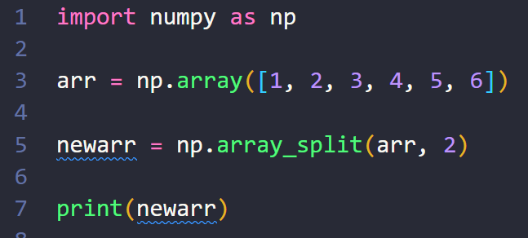
NumPy Splitting Array
Splitting is reverse operation of Joining.
Joining merges multiple arrays into one and Splitting breaks one array into multiple.
use array_split() for splitting arrays:
Pass the array about to be splitted and the number of splits.
[array([1, 2, 3]), array([4, 5, 6])]

Slide 46
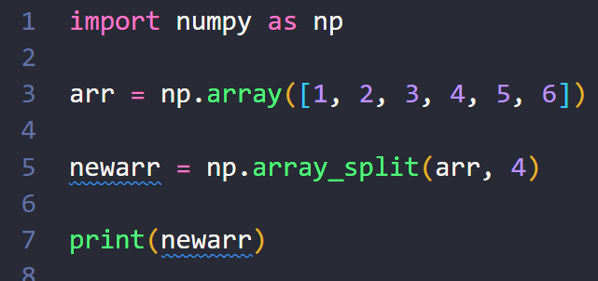
If the array has less elements than required, it will adjust from the end accordingly.
If the number of splits is 0
It raise a ‘ValueError: number sections must be larger than 0’
[array([1, 2]), array([3, 4]), array([5]), array([6])]

Slide 47
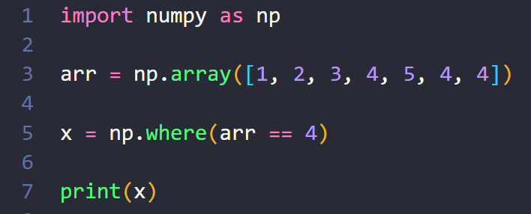
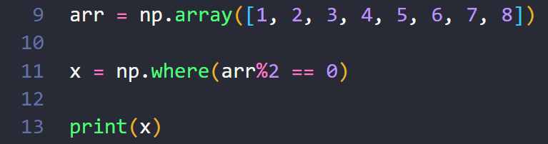
NumPy Searching Arrays
We can search an array for a certain value.
To search an array, use the where() method.
If the value being searched is in the array, the method return the indexes that get a match.
(array([3, 5, 6], dtype=int64),)
(array([1, 3, 5, 7], dtype=int64),)

Slide 48
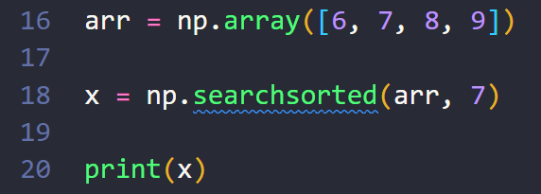
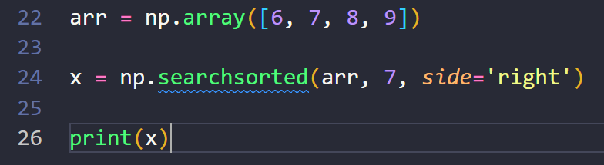
Search Sorted
There is a method called searchsorted() which performs a binary search in the array.
Return the index where the specified value would be inserted to maintain the search order
The searchsorted() method is assumed to be used on sorted arrays.
By default the left most index is returned, but we can give side='right' to return the right most index instead
1
2

Slide 49
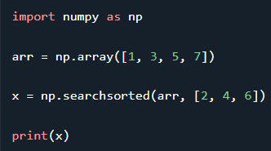
To search for more than one value, use an array with the specified values.
[1 2 3]

Slide 50
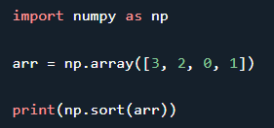
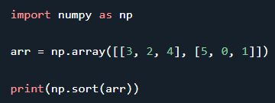
NumPy Sorting Arrays
Sorting means putting elements in an ordered sequence.
The NumPy ndarray object has a function called sort(), that will sort a specified array.
[0 1 2 3]
[[2 3 4]
[0 1 5]]

Slide 51
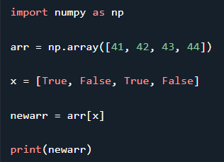
NumPy Filter Array
Getting some elements out of an existing array and creating a new array out of them is called filtering.
Using a boolean index list to fill the array
If the value at an index is True that element is contained in the filtered array, if the value at that index is False that element is excluded from the filtered array.
[41 43]

Slide 52
Resources

